Slide 1
Lecture 11 Heaps

Slide 2
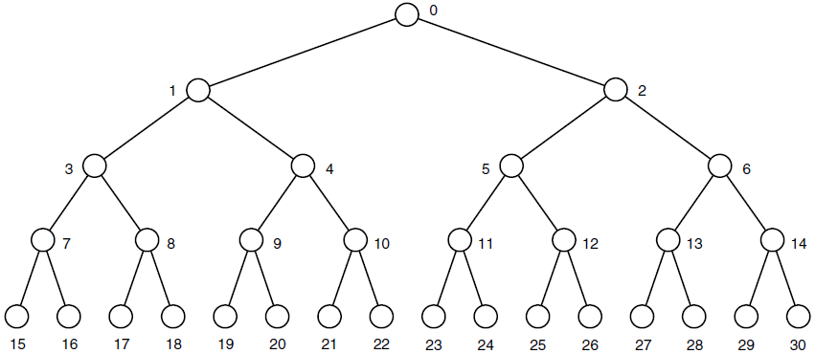
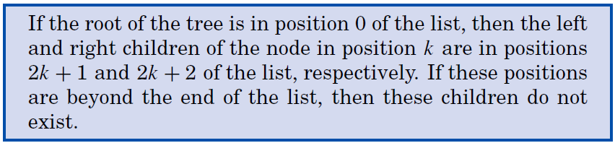
Trees, Lists, and Heaps

Slide 3
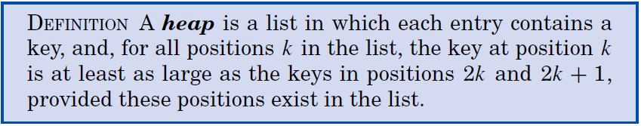
Heaps
A binary heap is a complete binary tree; that is, all levels of the tree, except possibly the last one (deepest) are fully filled, and, if the last level of the tree is not complete, the nodes of that level are filled from left to right.
A heap is not an ordered list, there is no necessary ordering between the keys in locations k and k+1(k>1);
The first entry must have the largest/smallest key in the max-heap/min-heap;
Heapsort is suitable only for contiguous lists.

Slide 4
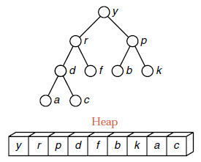
A Heap Example
设有n个元素的序列 k₁，k₂，…，k_{n}，当且仅当满足下述关系之一时，称之为堆。
k_{i} ≤ k_{2i}
k_{i} ≥ k_{2i}
或者
i=1, 2,… n/2
k_{i} ≤ k_{2i+1}
k_{i} ≥ k_{2i+1}

Slide 5
A Heap Example
有序列T1=（08, 25, 49, 46, 58, 67）和序列T2=（91, 85, 76, 66, 58, 67, 55）, 判断它们是否为“堆”？
1
1
08
91
2
2
3
3
25
49
85
76
4
5
6
4
5
6
7
46
58
67
66
58
67
55
√
（小根堆）
√
（大根堆）

Slide 6

Heapsort Method
Heapsort proceeds in two phases:
Arrange the entries in the list into a heap; (建堆)
Repeatedly remove the top of the heap and promote another entry to take its place (restore the heap). (调整堆)
In the second phase, we move the top of the heap to the last position.

Slide 7

A Heapsort Example
1
1
49
08
2
2
3
3
25
21
25
21
4
5
6
4
5
6
25*
16
08
25*
16
49
49 25 21 25* 16 08
08 25 21 25* 16 49
初始堆
交换 1号与 6 号记录

Slide 8
A Heapsort Example
1
1
25
08
16
2
2
3
3
08
25*
25
21
25*
21
4
5
6
4
5
6
08
16
49
08
25
49
25*
08 25 21 25* 16 49
25 08 21 25* 16 49
25 25* 21 08 16 49
16 25* 21 08 25 49
从 1 号到 5 号 重新
调整为堆
交换 1号与 5 号记录

Slide 9
A Heapsort Example
1
1
25*
08
2
2
3
3
16
21
16
21
4
5
6
4
5
6
08
25
49
25*
25
49
25* 16 21 08 25 49
08 16 21 25* 25 49
从 1号到 4号 重新
调整为堆
交换 1 号与 4 号记录

Slide 10
A Heapsort Example
1
1
21
08
2
2
3
3
16
08
16
21
4
5
6
4
5
6
25*
25
49
25*
25
49
21 16 08 25* 25 49
08 16 21 25* 25 49
从 1 号到 3号 重新
调整为堆
交换 1号与3 号记录

Slide 11
A Heapsort Example
1
1
16
08
2
2
3
3
08
21
16
21
4
5
6
4
5
6
25*
25
49
25*
25
49
16 08 21 25* 25 49
08 16 21 25* 25 49
从 1 号到 2 号 重新
调整为堆
交换 1 号与2 号记录

Slide 12
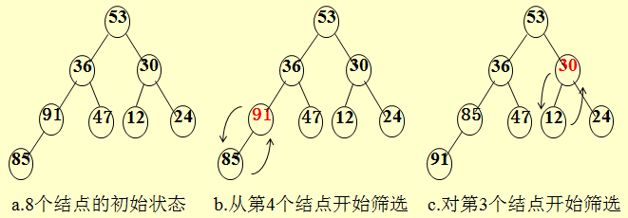
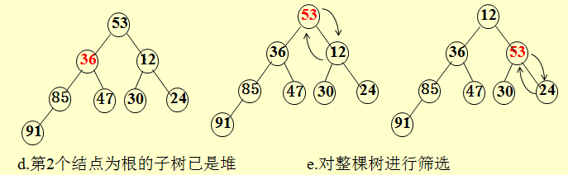
Building Heap Example

Slide 13
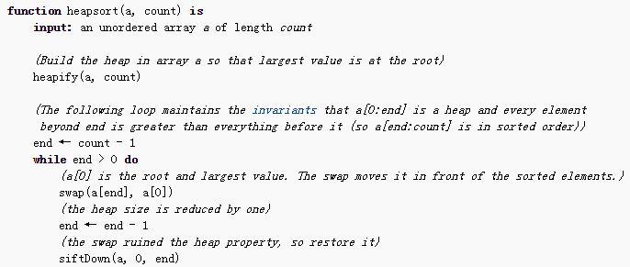
Heapsort Algorithm
堆排序

Slide 14
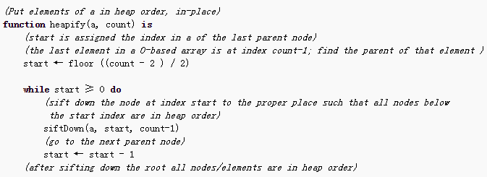
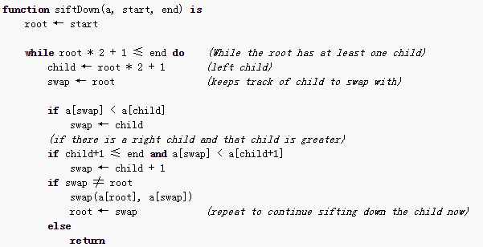
Heapsort Algorithm
建堆
向下筛选

Slide 15
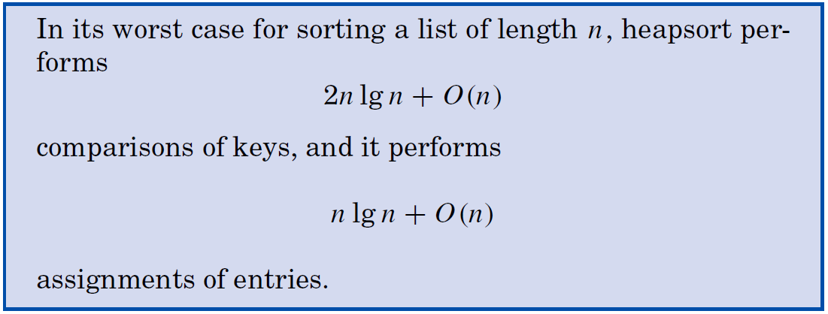
Analysis of Heapsort
The "siftDown" version of heapify has O(n) time complexity.
Empirical studies show that (as for selection sort) there is relatively little difference between the average and worst cases, and heapsort usually takes about twice as long as quicksort.

Slide 16
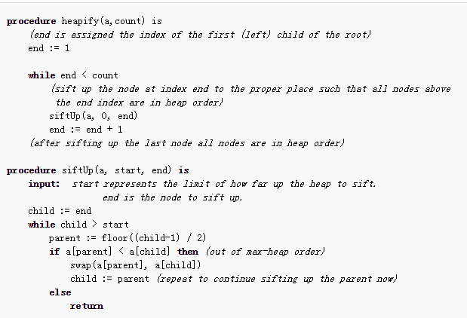
Another Heapify Method

Slide 17
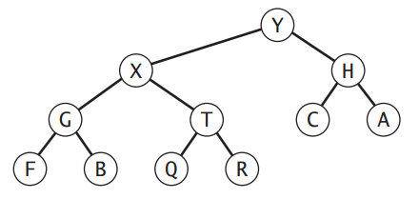
Exercise
Consider the following binary tree representation of a max-heap.
(a) Insert the key P into the heap
(b) Remove the largest key from the heap
Write down the resultant heap after each step using array representation.

Slide 18
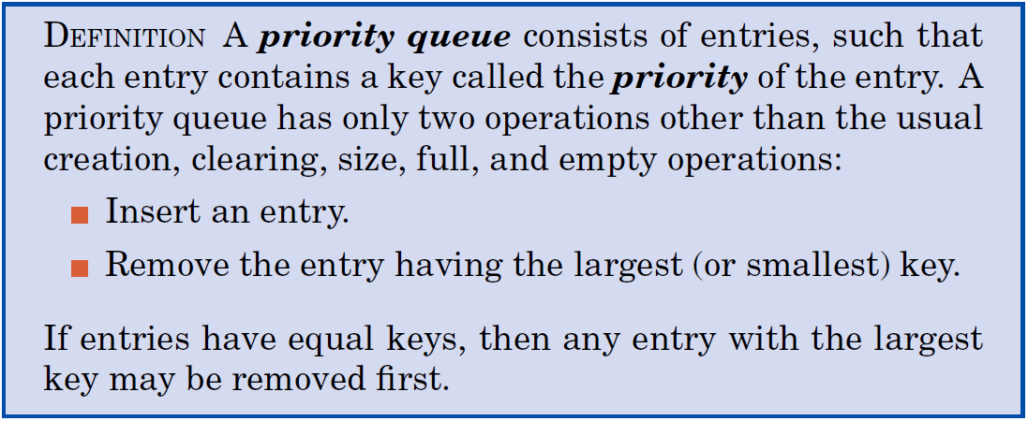
Priority Queues
Sift-up
Sift-down

Slide 19
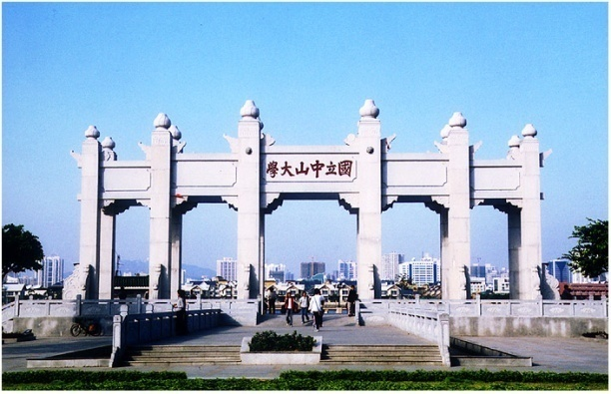
Thank you!

